Slide 1
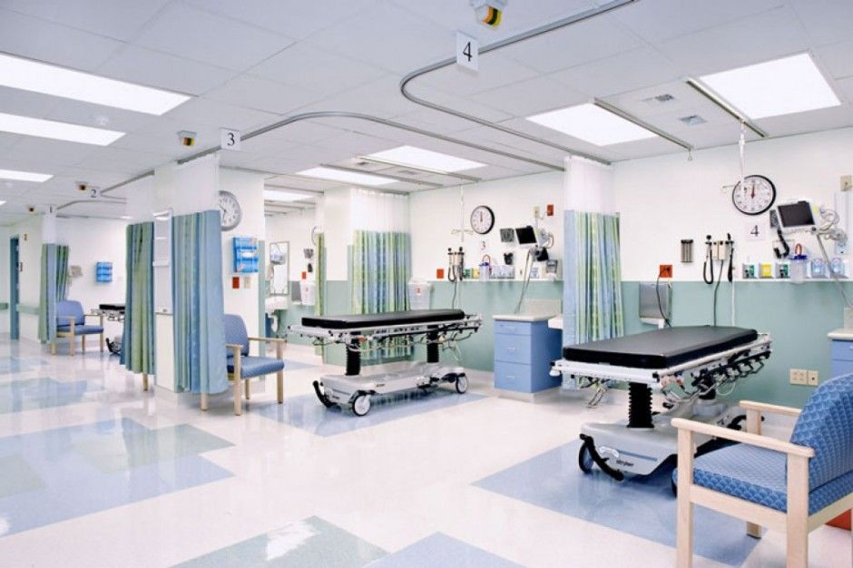
Project
Hospital Emergency Room
Patient Flow and outcome
- -
BY Yemi Praise
1
Notes:
1

Slide 2
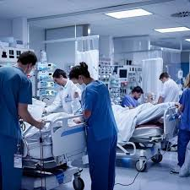




Introduction
2
Emergency Room
This project is to investigate about emergency room functioning by focusing patient characteristics, waiting periods, sources of referral, determinants of admission, as well as the association between patient satisfaction and service delivery.
Total Patient Visit
9216
Average Patient Wait Time
35.26
Maximum Patient Wait Time
60 Min
Minimum Patient Wait Time
10 min
Notes:
2

Slide 3
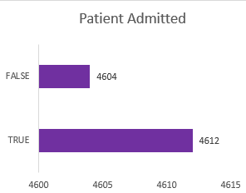
Insight
This show that about to 49.45% patient is not admitted.
While this show that about 50% of the patient are admitted which is very high for the emergency room to occupy
3
Notes:
3

Slide 4
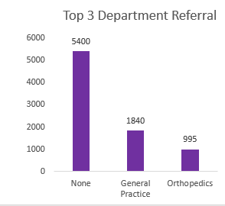

insight
It show that none referral patient has about (58.5%) which is high more than the referral patient
While the General Practice has about (22.3%) referral patient
And the Orthopedics has about (12.1%) referral patient .
4
Notes:
4

Slide 5

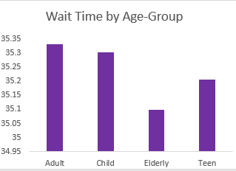
Insight
Adults invest the highest amount of time waiting, (35.34 minutes).
Children come close after that ( 35.28 minutes).
Teenagers wait a slightly shorter (35.19 minutes).
Elderly has the least amount of time waiting (35.08 minutes).
The differences are tiny (all less than 1 minute).
Your Logo Here
5
Notes:
5

Slide 6
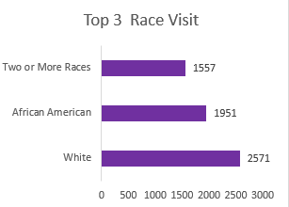
insight
The White group has the Largest race visitation with a cumulative visitation of 2571.
African Americans is the second with a cumulative visitation of 1,951 visits.
Two or More Races is third with a cumulative visitation of 1,557 visits.
6
Notes:
6

Slide 7
Insight
24%
Adults made up the majority of ER visits, accounting for a total of 4,783 patients, the largest number seen.
52%
The elderly patient have 2,198 visits, with a specific need for elderly emergency care.
The child patients have 1,413 visits, showing the need for immediate attention for the children..
Teens have the fewest ER visits at 822 patients, which is the smallest number of patient seen
15%
9%
7
Notes:
7

Slide 8
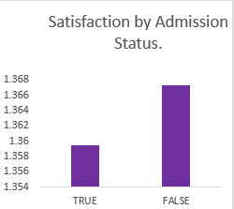
insight
Patients not admitted reported slightly higher satisfy (1.367) than those who were admitted (1.359)
Your Logo Here
8
Notes:
8

Slide 9
Recommendation
Strengthen primary care for managing non-emergency cases.
Check admission requirements to lower avoidable admissions.
initiate Observation Units for temporary periods of observation
Establish fast-track lanes for minor injuries/illness.
Strengthen health campaigns in ages 41–65 years (chronic disease; CVD;
.
Monitor admission rates by race and genders.
Educate ER personnel on communication, patient comfort, and empathy
9
Notes:
9

